Slide 1

딥러닝 (Deep Learning)
Homework 8
SSL for Computer Vision

Slide 2

Programming assignments
Deep Learning Basic MLP
Object Recognition ResNet
Face Recognition Free choice model
NLU CNN for Sentence Classification
Object Detection YOLO
Image Generation GAN, CGAN, DCGAN
NLG LSTM
SSL for Computer Vision ViT
SSL for NLP BERT
LLM ChatGPT

Slide 3
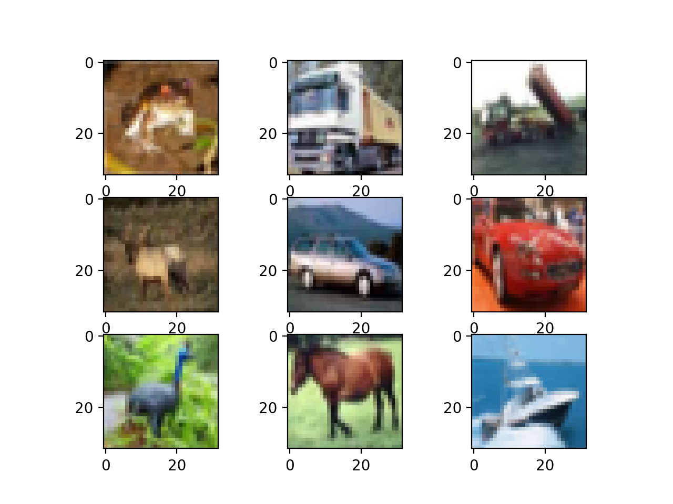
Homework 8: ViT
[Objective]
Your model should classify the images into 10 classes.
[Requirements]
1. Train ViT model using the CIFAR-10 dataset by changing various hyper-parameters.
(Basic code is provided)
2. You should experiment with the settings stated in the evaluation report and report the result of each setting.
3. You should attach the plot of the validation dataset accuracy plot.
4. You should report the experimental results.
(all kinds of additional experiments are recommended)
model
"Truck"

Slide 4
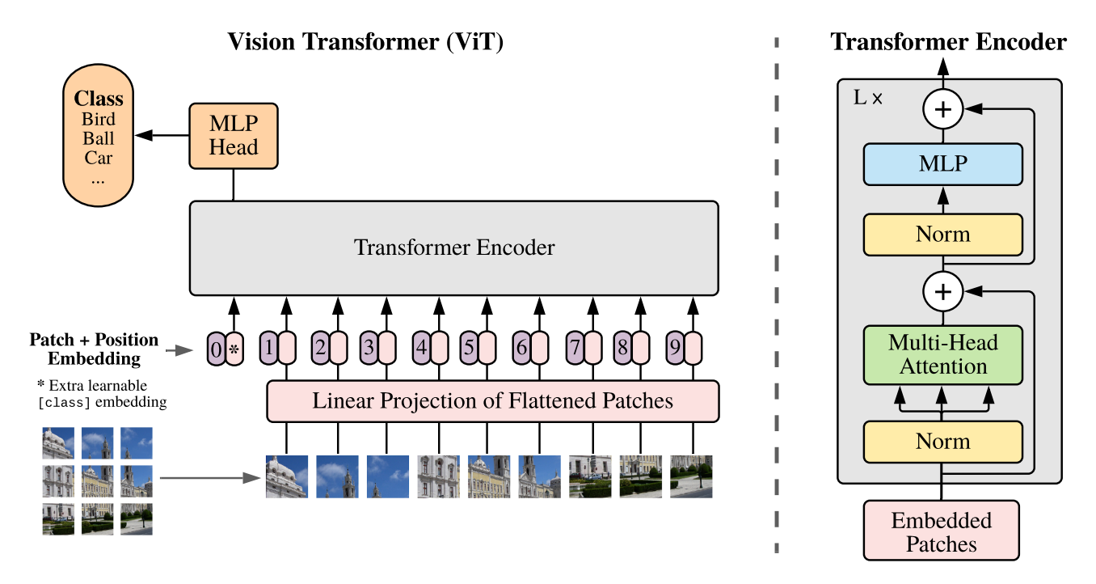
Homework 8: ViT
Pretrained on ImageNet-21k with 14 million images at 224x224 resolution
Processes images as sequences of 16x16 patches with positional embeddings
One can utilize [CLS] token for classification

Slide 5

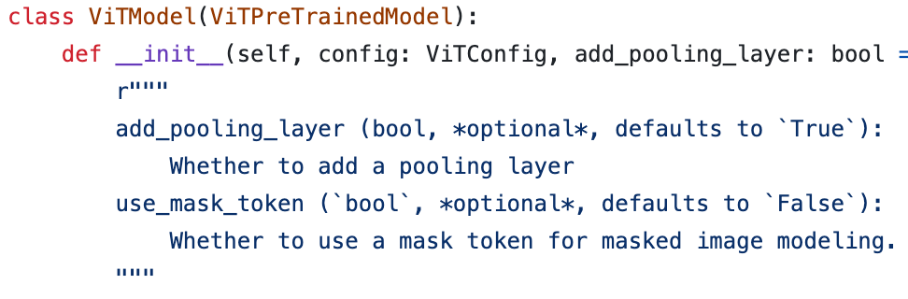
Homework 8: ViT
from transformers import ViTModel
class ViT_model(nn.Module):
def __init__(self, model_name, num_classes = 10):
super().__init__()
self.vit = ViTModel.from_pretrained(model_name)
self.classifier = nn.Linear(self.vit.config.hidden_size, num_classes)
def forward(self, x):
outputs = self.vit(**x)
last_hidden_states = outputs.last_hidden_state x = self.classifier(last_hidden_states[:, 0])
return x
... (Can be found in link 1)
ViTModel
[1] https://github.com/huggingface/transformers/blob/v4.52.3/src/transformers/models/vit/modeling_vit.py#L482

Slide 6
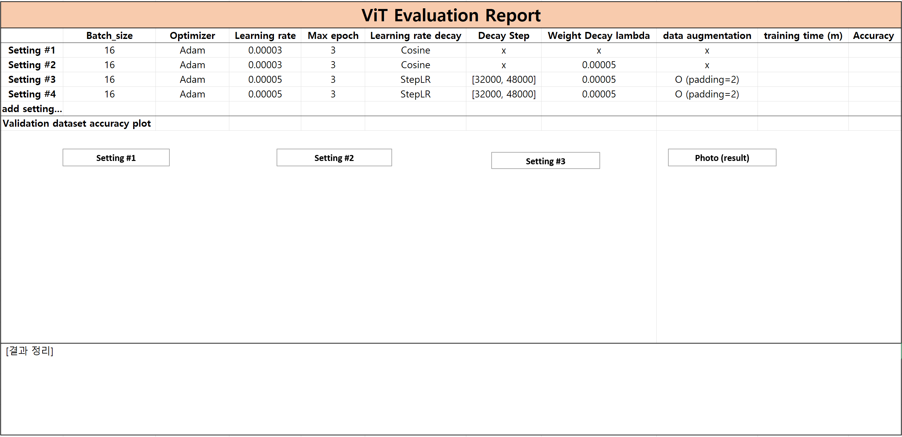
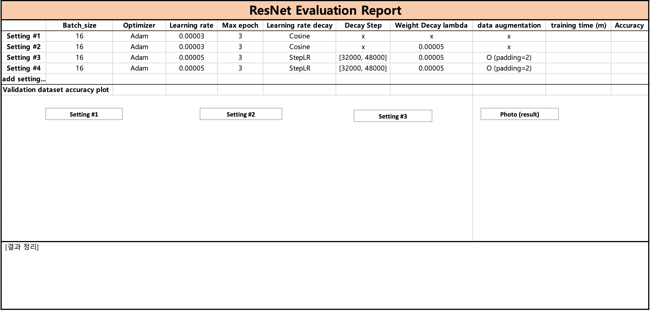


Homework 8: ViT
[Evaluation report]
dog
car

Slide 7
Homework 8: ViT
Evaluation Criteria
Simplicity | How concisely did you write the comments? - 배점 2점
Performance | How well did the results of the code perform? - 배점 2점 acc 98.5%이상 달성: 1점 개인 사진 추론: 1점
Brevity and Clarity | How concisely and clearly did you explain the results? - 배점 1점

Slide 8
Homework 8: ViT
Due to : ~ 6/13 (Fri) 23:59:59
Submission : Online submission on cybercampus
Your submission should include
The whole code of your implementation
The evaluation report
You must implement the components yourself!
File name : StudentID_Name_HW8.zip

Slide 9
Q&A

